Slide 1
Chapter 01 Introduction
Wei-Cheng Liu
Department of Communications Engineering, National Chung Cheng University

Slide 2
Outline
The Block Diagram of a Communication Systems
Channel Characteristics
Summary of Systems-Analysis Techniques
Probabilistics Approaches to System Optimization
Preview of This Book

Slide 3
Major Events and Inventions in the Development of Electrical Communications (1/3)
Notes:
1791 Alessandro Volta: 義大利物理學家，galvanic cell
1826 Georg Simon Ohm: 德國物理學家
1904 thermionic diode: 熱離子二極體，也就是真空管

Slide 4
Major Events and Inventions in the Development of Electrical Communications (2/3)

Slide 5
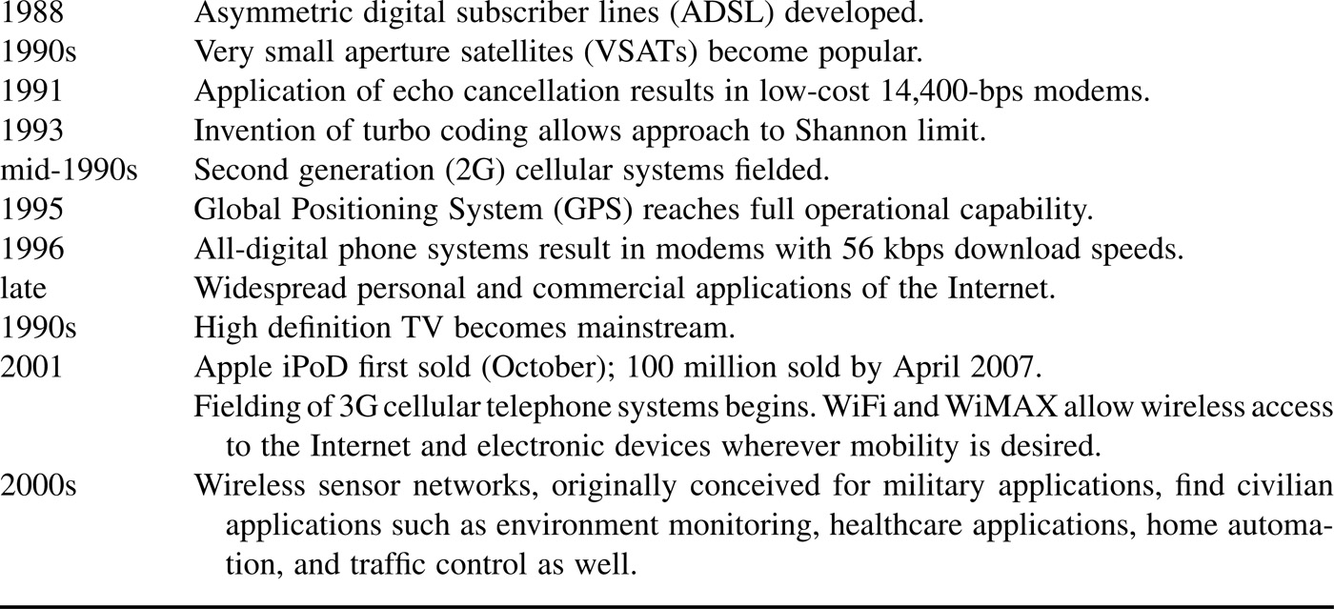
Major Events and Inventions in the Development of Electrical Communications (3/3)

Slide 6
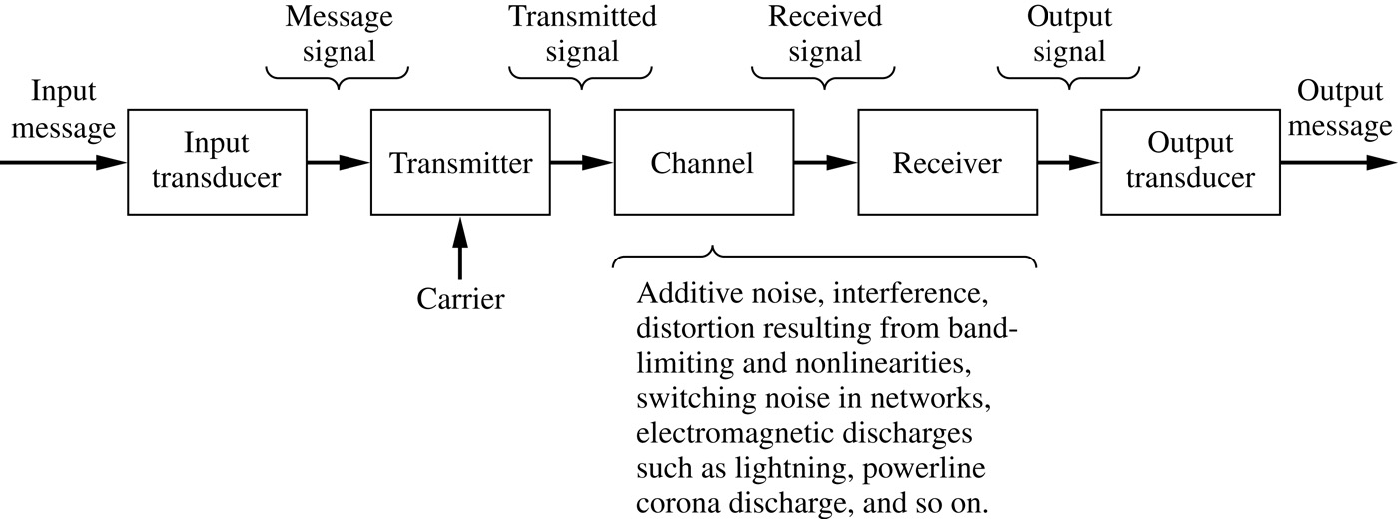
The Block Diagram of a Communication System

Slide 7
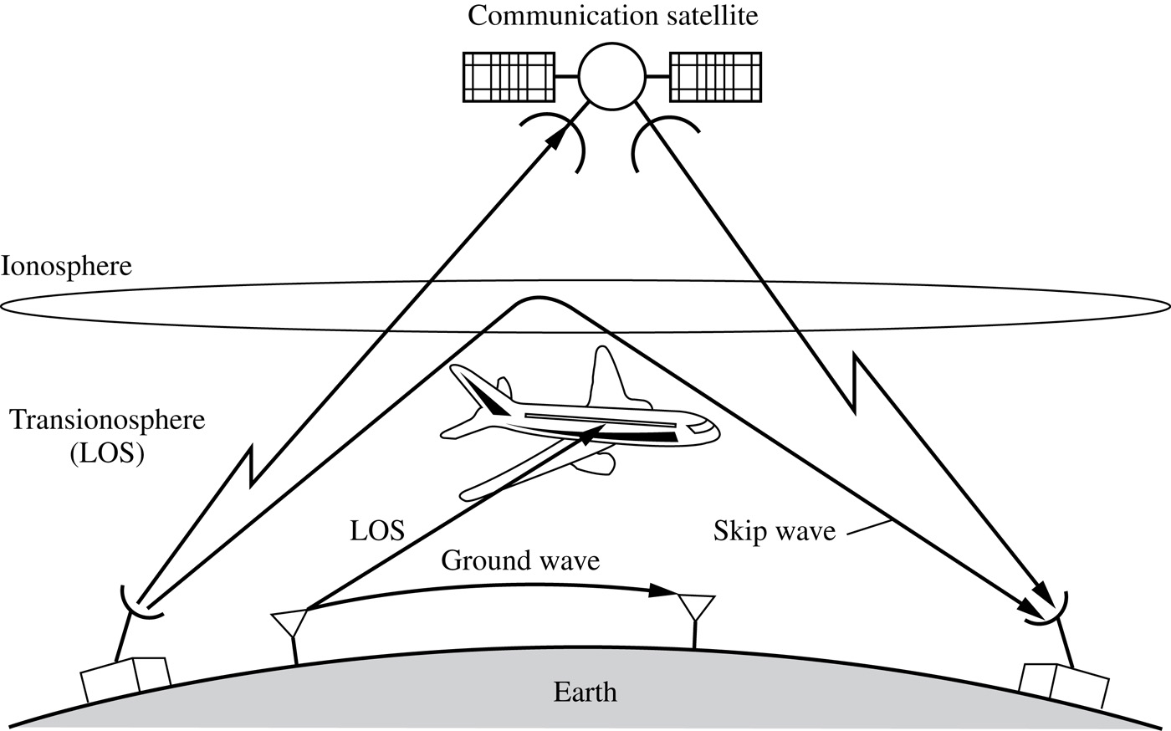
The Various Propagation Modes for Electromagnetic Waves
(LOS stands for line of sight)

Slide 8
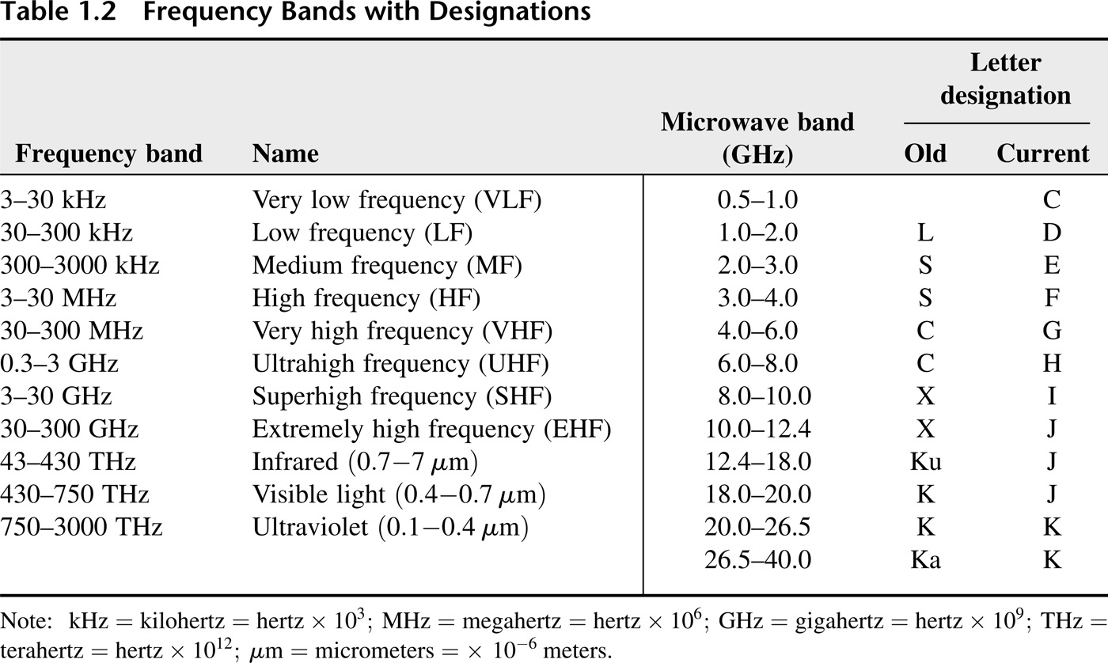
Frequency Bands with Designations

Slide 9
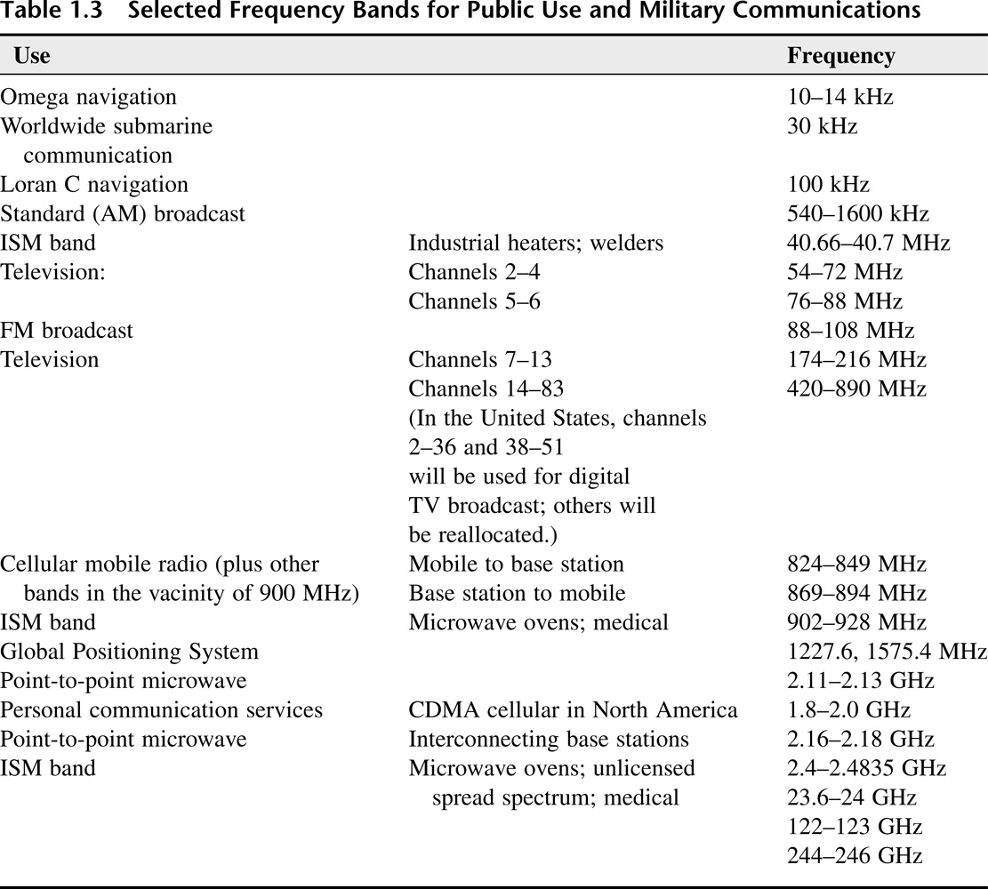
Selected Frequency Bands for Public Use and Military Communications

Slide 10
Specific Attenuation Due to Oxygen and Water Vapor (concentration of 7.5 g/m³)

Slide 11
Specific Attenuation Due to Rainfall at Rates of 10, 50, and 100 mm/h

Slide 12
Summary of Systems Analysis Techniques
Time-Domain and Frequency-Domain Analyses
Modulation and Communication Theories

Slide 13
Probabilistic Approaches to System Optimization
Statistical Signal Detection and Estimation Theory
Information Theory and Coding
Recent Advances

